Slide 1
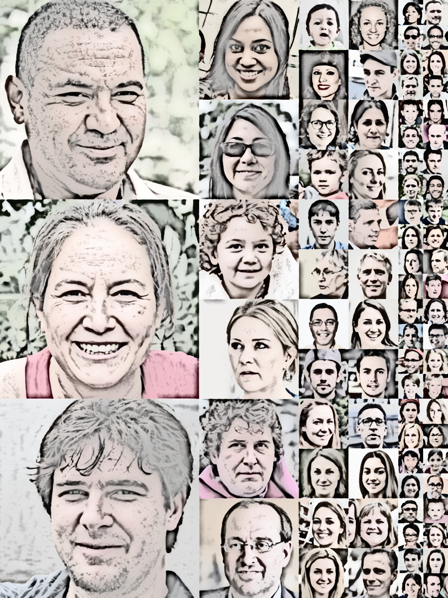
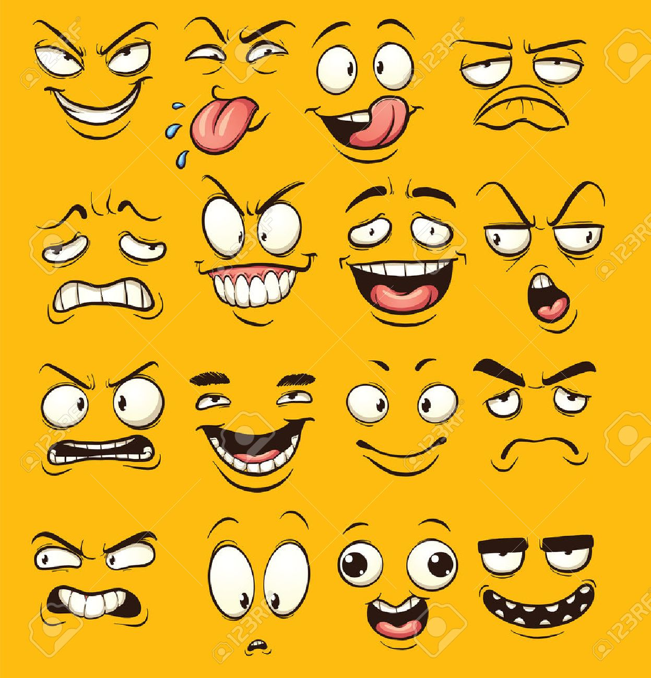

Deep Fakes
CSCI 599 – Applied Machine Learning for Games
Prof. Mike Zyda
Adarsh Gopalakrishnan
Niveditha Kumaran

Slide 2
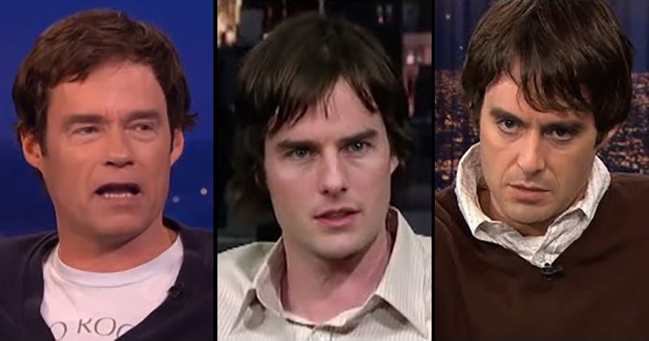
Deep Fakes
Bill Hader
Arnold Sc Tom Cruise Al Pacino

Slide 3
OBJECTIVE
Face detection in input video
Replacement with custom face
E.g. swapping face of comedian imitating a particular person
Selecting personality from a list

Slide 4
IMPLEMENTATION
Deep Fakes can be created from a number of approaches
Image-Image Translation ( Conv De-conv)
Also known as U-Networks
Generative Adversarial networks
Used to recreate an image with slight modifications
Auto Encoders
Effective method to create patterns on images

Slide 5
Rough project steps
Data collection through video
Training of deep learning models on sample data
Comparison of performance of videos

Slide 6
Thank You!

